Slide 1
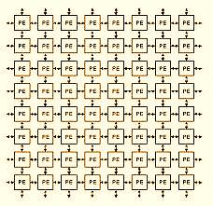
Arrays& Strings

Slide 2
Objectives
Understanding :
1D array declaration , initialization
Programs using 1D arrays
2D Array declaration, initialization
Programs using 2D arrays
Strings definition, declaration, initialization
Reading Strings
String Handling Functions
Programs using strings

Slide 3
1D-Arrays
Definition:
An array is a group of related data items of same data type.
The array elements are placed in a contiguous memory locations.
A particular value in an array is indicated by its index number or subscript in square brackets after the array name.
The array index always starts from the position 0.
Notes:
Array: C++ provides a data structure, the array, which stores a fixed-size sequential collection of elements of the same type. An array is used to store a collection of data, but it is often more useful to think of an array as a collection of variables of the same type. Instead of declaring individual variables, such as number0, number1, ..., and number99, you declare one array variable such as numbers and use numbers[0], numbers[1], and ..., numbers[99] to represent individual variables. A specific element in an array is accessed by an index. All arrays consist of contiguous memory locations. The lowest address corresponds to the first element and the highest address to the last element.

Slide 4
1D-Arrays
Array Declaration:
data-type name [size];
where data-type is a valid data type (like int, float,char...)
name is a valid identifier
size specifies how many elements the array has to contain.
size field is always enclosed in square brackets [ ] and takes integer constant.
For example an array salary containing 5 elements is declared as follows int salary [5];
Notes:
This is a single-dimension array ie. with one subscript. Eg. data-type name [size]. . The arraySize must be an integer constant greater than zero and type can be any valid C++ data type. For example, to declare a 10-element array called balance of type integer, use this statement: int balance[10];

Slide 5
1D-Arrays
Name : salary[0] salary[1] salary[2] salary[3] salary[4]
Values :
Address: 1000 1002 1004 1006 1008
These items are accessed using the same name using a single subscript. E.g salary [1], salary [4] e.t.c
10 | 20 | 30 | 40 | 50

Slide 6
1D Array-Rules for subscript:
A subscript can be integer constant, Integer variable like i, or expressions that yield integers.
The Maximum subscript value appearing in a program should not exceed the declared size.
The subscript value ranges from 0 to one less than the maximum size. For example, If the array size is 5 , then the first subscript is 0, the second is 1 and so on the last subscript is 4. In general i^{th} element has subscript (i-1).

Slide 7
Arrays - 1D
Total size:
The Total memory that can be allocated to 1Darray is computed as
int total_size = size *(sizeof(data_type));
where:
size→ number of elements in 1-D array
data_type→ data type of array elements.
sizeof()→ is an unary operator which returns the size of expression or data type in bytes.
For example,
For the array int salary [5], size can be found as:
int s = 5 * size_of(int);
Notes:
The sizeof operator yields the size of its operand with respect to the size of type . When the sizeof operator is applied to an object of type char, it yields 1. When the sizeof operator is applied to an array, it yields the total number of bytes in that array. One of the advantages of the sizeof operator used to get the number of members of the array and it can be used on a for loop to scan an array, either to locate the members or to look for a value in the array.

Slide 8
Arrays - 1D
If the values of array ‘mark’ are 32, 27,64,18,95 then these values are
stored in ‘mark’ as follows.
32
27
64
18
95
mark[0]
mark[1]
mark[2]
mark[3]
mark[4]
& mark [0]
mark
Whenever we refer the array name, we are in turn referring to the address of the 1st element of the array as shown above.
Notes:
The array name indicates the address of the first element of an array. i.e. , an array name itself is a pointer.

Slide 9
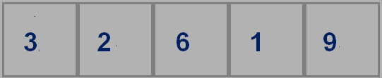
Arrays - 1D
While displaying array elements
If cout<< arr means it will display first element address eg. 0x8f8dffec
If cout<< &arr means it also display first element address eg. 0x8f8dffec
If cout<< &arr[0] means it also display first element address eg. 0x8f8dffec
If cout<< arr[0] means it will display first element of an array eg. 3

Slide 10
Initializing one-dimensional array
At Compile Time (static)
type array-name [size]={list of values};
Where:
type→ basic data type
array-name→ name of the array.
size→ maximum number of elements and may be
omitted.
List of values→ values separated by commas.
E.g.
int number[3] ={ 10,20,30};
int number[ ] ={ 10,20,30,40}; //The size is assigned to 4

Slide 11
Initializing one-dimensional array
At run time [during program execution]
e.g. Initialize all the elements of an integer array ‘values’ to zero
int arr[100];
for (i=0; i<100; i++)
{
arr[i] = 0;
}
Here the elements of the array will not be known during the compile time. The elements are initialized only during the run-time.

Slide 12
Printing 1D array
int x[3] = {9,11,13};
cout << x[0] << endl;
cout << x[1] << endl;
cout << x[2] << endl;
Output:
9
11
13
or
int x[3] = {9,11,13};
for (int i = 0; i<3; i++)
cout << x[i] << endl;

Slide 13
Reading and Displaying 1D Arrays
#include<iostream.h>
void main()
{
int arr[50],n,i;
cout<< " enter the number of elements\n";
cin>>n;
cout<< “Enter the elements:”;
for(int i=0;i<n;i++)
cin>> arr[i];
cout<< " The array elements are\n";
for(int i=0; i<n; i++)
cout<<arr[i];
}

Slide 14
Program to add two array elements and store the corresponding elements sum in another array
int a[100],b[100],c[100],n,m,i;
cout<<"enter no. of elements in 1st array\n";
cin>>n; //first array
cout<<“Enter first array : “;
for(i=0;i<n;i++)
cin>>a[i];
cout<<"enter no of elements in second array\n";
cin>>m; //second array
for(i=0;i<m;i++)
cin>>b[i];
if(m==n) // checking for same size of arrays
{
for(i=0;i<m;i++)
c[i]=a[i]+b[i];
cout<<“Sum of given array
elements\n”;
for(i=0;i<n;i++)
cout<<c[i]<<endl;
}
else
cout<<"cannot add“;

Slide 15
Displaying elements of an array in reverse order.
int a[5], n, i;
cout<<“Enter values\n";
for(i=0;i<5;i++)
cin>>a[i];
cout<<“\n Reverse of array\n”;
for(i=n-1;i>=0;i--) // reverse loop
cout<<a[i]<<"\t“;
Example : a[5 ]={1, 2, 3, 4, 5}
Reverse printing of array
5 4 3 2 1
Array before Array after
a[0]=1 a[0]=1
a[1]=2 a[1]=2
a[2]=3 a[2]=3
a[3]=4 a[3]=4
a[4]=5 a[4]=5

Slide 16
Write a program to reverse an array using only one array
int a[5],i,j,n, temp;
cout<<"enter n \n";
cin>>n;
cout<<"\n Enter array elements";
for(i=0;i<n;i++)
cin>>a[i];
for(i=0,j=n-1;i<n/2; i++,j--)
{
temp=a[i];
a[i]=a[j];
a[j]=temp;
}
cout<<"\n Reversed array\n";
for(i=0;i<n;i++)
cout<<a[i]<<"\t";
}
Example : a[ 5]={1, 2, 3, 4, 5}
Reversed array
5 4 3 2 1
Array Reversed array
a[0]=1 a[0]=5
a[1]=2 a[1]=4
a[2]=3 a[2]=3
a[3]=4 a[3]=2
a[4]=5 a[4]=1

Slide 17
Write the programs for the following questions
Find the largest and smallest element in an array.
2. To insert an element into an array and to delete an element from an array.
3. To print all the prime numbers in a given array.
4. To arrange the array elements in ascending/descending order using
Selection/Bubble sort.
5. To insert an element into a sorted array (after insertion remains sorted).
6. To search for a given number in an array using Binary Search method
7. To delete all the duplicate elements of an array.

Slide 18
Syntax
1D Array:
Syntax: type array_name[size];
Memory Requirement:
Total size =size *(sizeof(data_type));
Initialization:
type array-name [size]={list of values}
Write and Read:
for(i=0;i<n;i++) for(i=0;i<n;i++)
cin>>a[i]; cout<<a[i];

Slide 19
1-D Arrays
Searching and Sorting Techniques

Slide 20
Objectives
Understanding of:
Searching Techniques
Linear Search
Binary Search
Sorting Techniques
Bubble Sort
Selection Sort

Slide 21
Searching & Sorting
Searching refers to finding whether a data item is present in the set of items or not.
Sorting refers to the arrangement of data in a particular order.
Sorting and searching have many applications in the area of computers.

Slide 22
Linear search
The Linear Search is applied on the set of items that are
not arranged in any particular order.
In linear search , the searching process starts from the
first item.
The searching is continued till either the item is found or
the end of the list is reached indicating that the item is
not found.

Slide 23
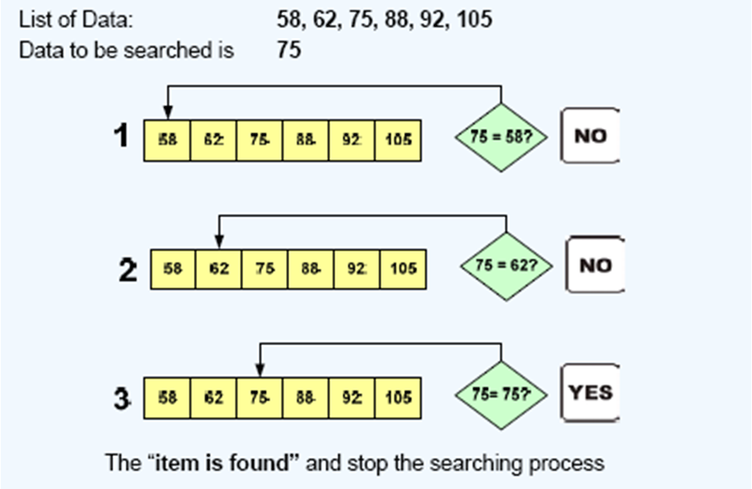
Linear search- Example 1

Slide 24
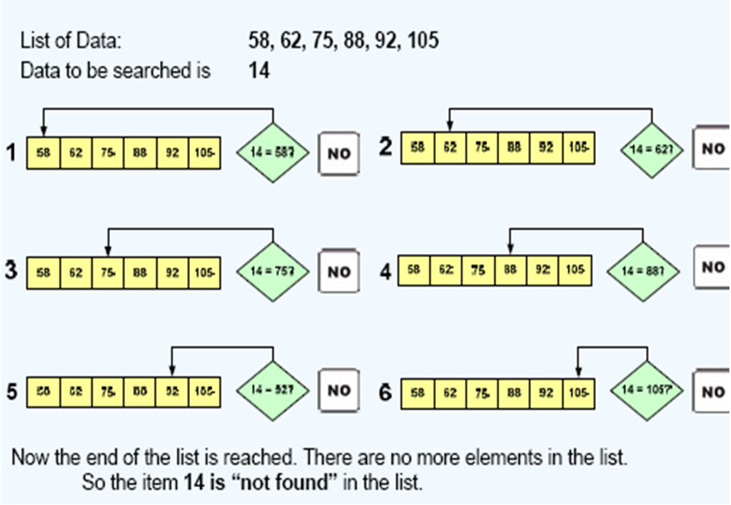
Linear search- Example-2

Slide 25
WAP to search an element in an array using linear search
for(i=0; i<n; i++)
{
if(a[i]==key)
{
found=1;
break;
}
}
if(found==1)
cout<<“Element is found ;
else
cout<<“Element is not
found“;
}
void main()
{
int a[100],i,n,key,found=0;
cout<<"enter no of elements";
cin>>n;
for(i=0;i<n;i++)
cin>>a[i];
cout<<"enter the element to be searched";
cin>>key;

Slide 26
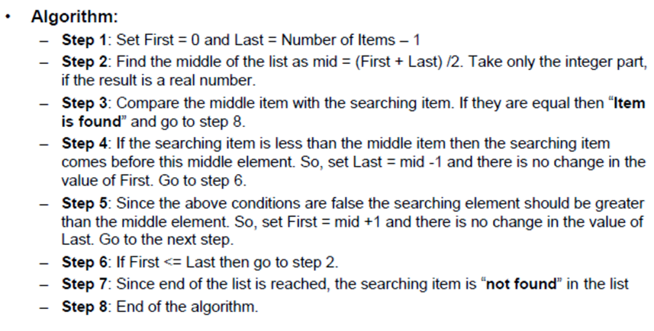
Binary Search
A binary search is a searching technique that can be applied only
to sorted list of items.
Notes:
Binary Search:
Binary search relies on a divide and conquer strategy to find a value within an already-sorted collection. Binary search requires a sorted collection. This means the collection must either be sorted before searching, or inserts/updates must be smart. Also, binary searching can only be applied to a collection that allows random access . The only time binary searching doesn't make sense is when the collection is being frequently updated, since re-sorting will be required.

Slide 27
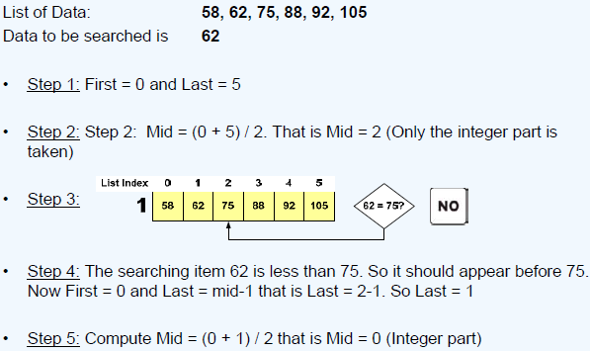
Binary Search – example-1

Slide 28
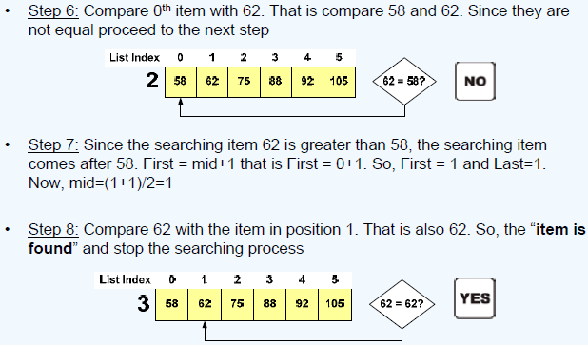
Binary Search – example-1

Slide 29
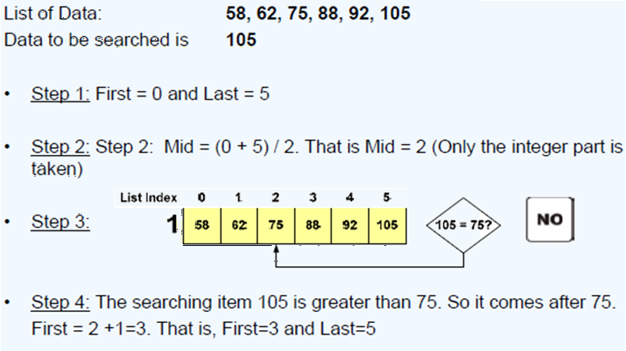
Binary Search – example-2

Slide 30
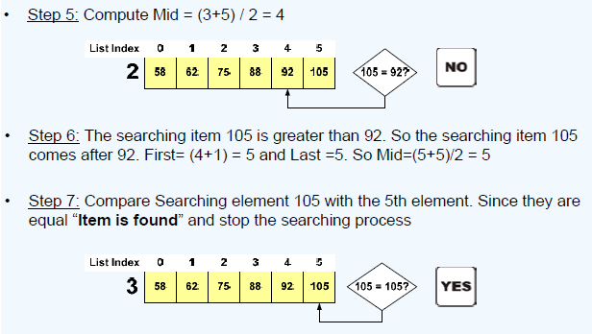
Binary Search – example-2

Slide 31
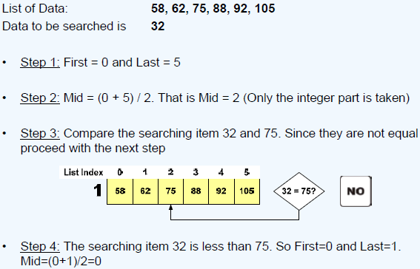
Binary Search – example-3

Slide 32
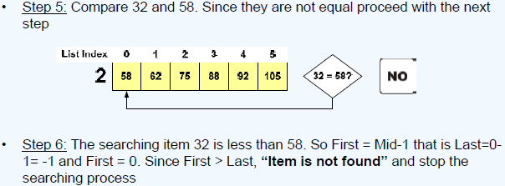
Binary Search – example-3

Slide 33
To search for a given number in an array using Binary Search method
while( low <= high)
{
mid= (low + high) / 2;
if (key == a[mid])
{
found = 1;
break;
}
else if ( key < a[mid] )
high = mid - 1;
else
low = mid + 1;
}
if( found == 1)
cout<<"SUCCESSFUL
SEARCH\n";
else
cout<<"Search is FAILED\n";
}
}
int main()
{
int a[10],i,n,low,high,mid,found,key;
cout<<"Enter no of elements\n";
cin>>n;
cout<<"Enter array elements in sorted order\n";
for(i=0;i<n;i++)
cin>>a[i];
cout<<"The elements of array are:\n";
for(i=0;i<n;i++)
cout<<a[i]<<"\t";
cout<<"\nEnter key to be searched\n";
cin>>key;
/* Binary search on sorted array */
found = 0;
low=0;
high=n-1;

Slide 34
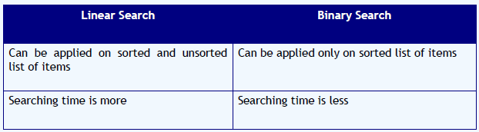
Linear versus Binary Search
Notes:
A linear search is the most basic of search algorithm you can have. A linear search sequentially moves through your collection (or data structure) looking for a matching value Linear searches don't require the collection to be sorted.
Searching is an important function in computer science. Many advanced algorithms and data structures have been devised for the sole purpose of making searches more efficient. And as the data sets become larger and larger, good search algorithms will become more important. At one point in the history of computing, sequential search was sufficient. But that quickly changed as the value of computers became apparent. Linear search has many interesting properties in its own right, but is also a basis for all other search algorithms. Binary search is the next logical step in searching. By dividing the working data set in half with each comparison.

Slide 35
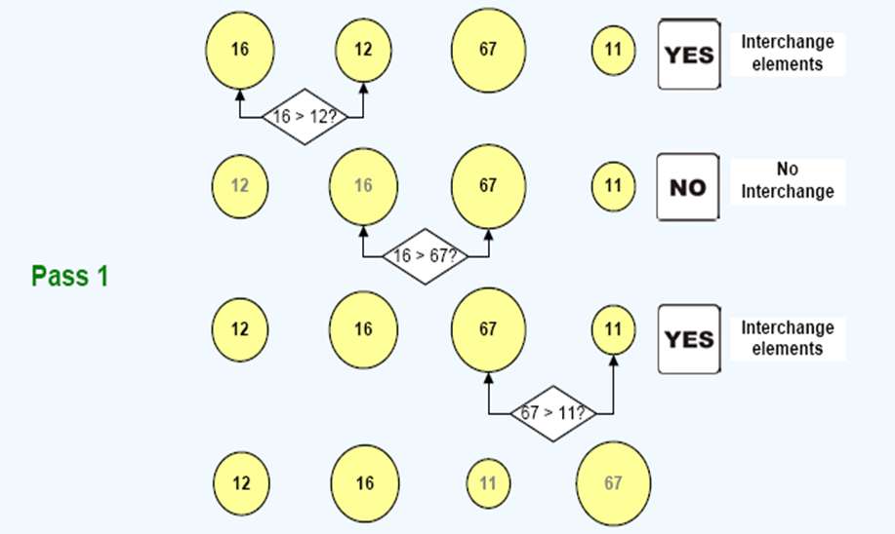
Bubble Sort- Example

Slide 36
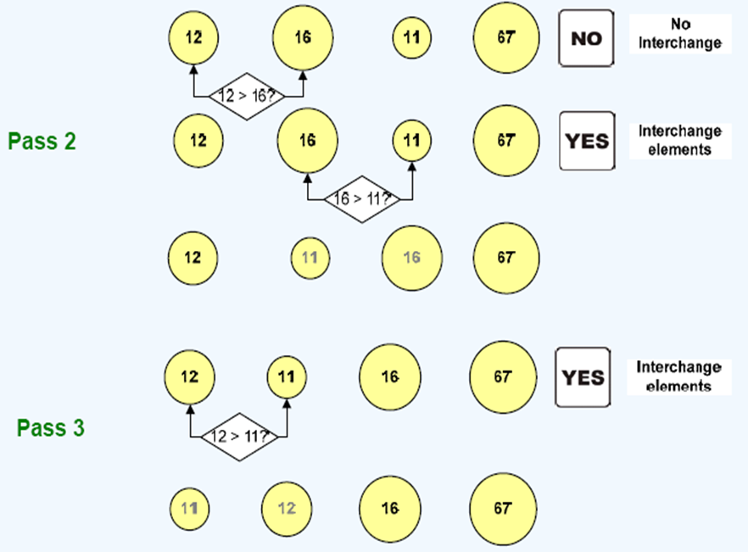
Bubble Sort- Example

Slide 37
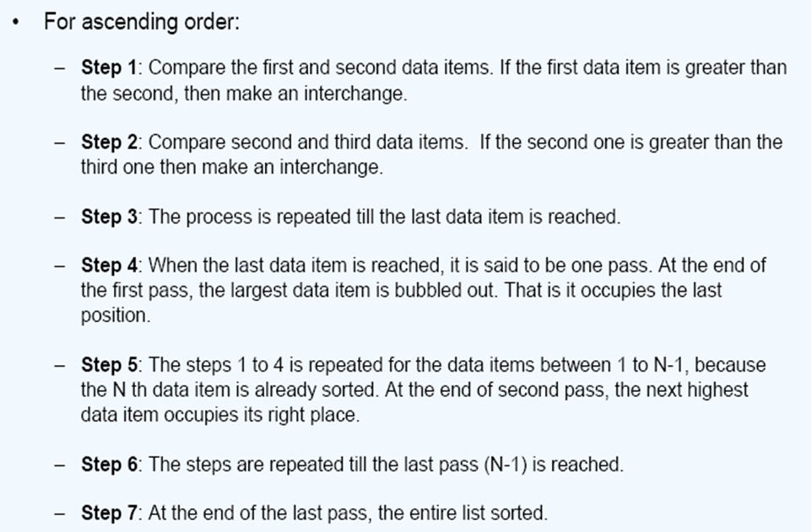
Bubble Sort Algorithm
Notes:
A sorted array is an array data structure in which each element is sorted in numerical, alphabetical, or some other order, and placed at equally spaced addresses in computer memory. It is typically used in computer science to implement static lookup tables to hold multiple values which have the same data type. Sorting an array is useful in organizing data in ordered form and recovering them rapidly.

Slide 38
To arrange the array elements in ascending/descending order using Bubble sort
for(i=0;i<n-1;i++)
{
for(j=0;j<n-i-1;j++)
{
if(a[j]>a[j+1]) // a[j]<a[j+1]
{
temp=a[j];
a[j]=a[j+1];
a[j+1]=temp;
}
}
}
cout<<"\nThe elements of array after sorting are:\n";
for(i=0;i<n;i++)
cout<<a[i]<<"\t";
}
int main()
{
int a[10],i,j,temp,n;
cout<<"Enter no of elements\n";
cin>>n;
cout<<"Enter array elements\n";
for(i=0;i<n;i++)
{
cin>>a[i];
}
cout<<"The elements of array are:\n";
for(i=0;i<n;i++)
cout<<a[i]<<"\t";

Slide 39
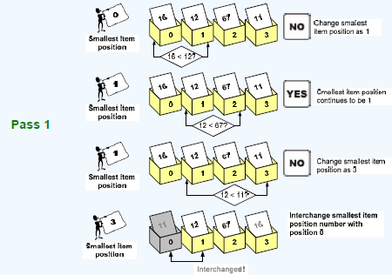
Selection Sort – example

Slide 40
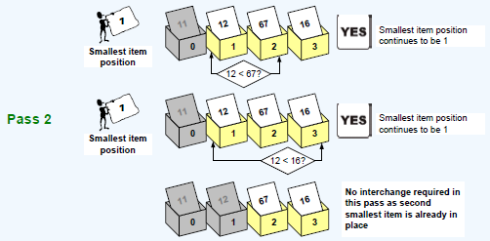
Selection Sort – example

Slide 41
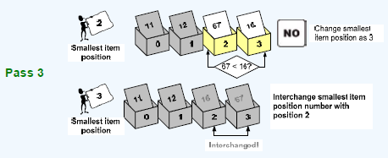
Selection Sort – example

Slide 42
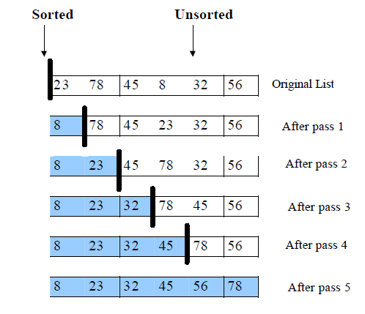
Selection Sort - Example
Notes:
Selection Sort:
We find the smallest element from the unsorted sublist and swap it with the element at the beginning of the unsorted data.
After each selection and swapping, the imaginary wall between the two sublists move one element ahead, increasing the number of sorted elements and decreasing the number of unsorted ones.
Each time we move one element from the unsorted sublist to the sorted sublist, we say that we have completed a sort pass.
A list of n elements requires n-1 passes to completely rearrange the data.

Slide 43
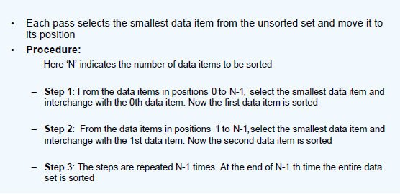
Selection Sort
Notes:
The aim of sorting algorithms is to put unordered information in an ordered form. There are many sorting algorithms, such as: - Selection Sort - Bubble Sort - Insertion Sort - Merge Sort and - Quick Sort. The first three are the foundations for faster and more efficient algorithms.

Slide 44
Selection Sort – program
for(i = 0; i < n-1; i++)
{
pos = i; small = a[i];
for(j=i+1; j<n; j++)
{
if(small > a[j])
{
pos = j;
small = a[j];
}
}
a[pos] = a[i];
a[i] = small;
}
cout<<"\nThe elements of array
after sorting are:\n";
for(i=0;i<n;i++)
cout<<a[i]<<"\t";
}
int main()
{
int a[10],i,j,pos,small,n;
cout<<"Enter no of elements\n";
cin>>n;
cout<<"Enter array elements\n";
for(i=0;i<n;i++)
cin>>a[i];
cout<<"The elements of array are:\n";
for(i=0;i<n;i++)
cout<<a[i]<<"\t";

Slide 45
2-D ARRAYS

Slide 46
2 dimensional Arrays
It is an ordered table of homogeneous elements.
It can be imagined as a two dimensional table made of elements, all of them of a same uniform data type.
It is generally referred to as matrix, of some rows and some columns.
It is also called as a two-subscripted variable.
For example:
int marks[5][3];
The example tells that marks is a 2-D array of 5 rows and 3 columns.
Notes:
Two Dimensional Array" is a simple form of multi-dimensional array that stores the array elements in a row, column matrix format.
Syntax: type array_name[array_size1][array_size2]

Slide 47
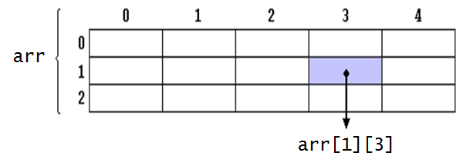
2 dimensional Arrays
Declaration
type array_name[row_size][column_size];
For example,
int arr [3][5];
arr represents a two dimensional array or table having 3 rows and 5 columns and it can store 15 integer values.

Slide 48
An array int mark[5][4] is represented as follows
Student [subscript] | Tests1 [0] | Test 2 [1] | Test 3 [2] | Test 4 [3]
1 [0] | 20 (mark[0][0]) | 20 (mark[0][1]) | 21 (mark[0][2]) | 22 (mark[0][3])
2 [1] | 18 (mark[1][0]) | 23 (mark[1][1]) | 22 (mark[1][2]) | 20 (mark[2][3])
3 [2] | 11 (mark[2][0]) | 22 (mark[2][1]) | 15 (mark[2][2]) | 16 (mark[2][3])
4 [3] | 22 (mark[3][0]) | 21 (mark[3][1]) | 23 (mark[3][2]) | 24 (mark[3][3])
5 [4] | 17 (mark[4][0]) | 15 (mark[4][1]) | 16 (mark[4][2]) | 18 (mark[4][3])

Slide 49
Initialization of two dimensional arrays
Initialization of two dimensional arrays
type array-name [row size] [col size ] ={list of values};
Ex:- int table [2][3]={0,0,0,1,1,1};
→ initializes the elements of the first row to zero and the second row to 1.
Initialization is always done row by row
The above statement can be equivalently written as:
int table [2][3]={{0,0,0},{1,1,1}};
OR in matrix form it can be written as
int table [2][3]= { {0,0,0},
{1,1,1} };

Slide 50
Initialization of two dimensional arrays
When array is completely initialized with all values , we need not specify the first dimension.
int table [][3]= { {0,0,0},
{1,1,1 }
};
If the values are missing in an initializer, they are set to zero
int table [2][3]= { {1,1},
{2}
};
will initialize the first two elements of the first row to 1, the first element of the second row to two, and all other elements to zero.
To set all elements to zero
int table [3][3]={{0},{0},{0}};

Slide 51
Read a matrix and display it
void main()
{
int i,j,m,n,a[100][100];
cout<<"enter dimension for a:";
cin>>m>>n;
cout<<"\n enter elements\n";
for(i=0;i<m;i++)
{
for(j=0;j<n;j++)
cin>>a[i][j];
}
for(i=0;i<m;i++)
{
for(j=0;j<n;j++)
cout<<"\t"<<a[i][j];
cout<<“\n”;
}
}

Slide 52
Programs on 2D-arrays
Addition of two Matrices
Row Sum & Column Sum of a matrix
Multiplication of two Matrices
Trace and Norm of a Matrix
Check whether a given Matrix is Symmetric or not
Check whether a given Matrix is Magic Square or not

Slide 53
CHARACTER ARRAYS STRINGS

Slide 54
Strings
Definition:
A string is an array of characters.
Any group of characters (except double quote sign) defined between double quotation marks is a constant string.
The common operations performed on strings are:
Reading and writing strings
Combining strings together
Copying one string to another
Comparing strings to another
Extracting a portion of a string ..etc.
Notes:
A new data type , the character string, which is used to represent a sequence of characters regarded as a single data item. In C++ strings of characters are held as an array of characters, one character held in each array element.

Slide 55
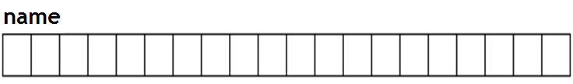
Declaration and initialization
char string_name[size];
The ‘size’ determines the number of characters in the string.
For example, consider the following array:
char name [20];
It is an array that can store up to 19 elements of type char and a null character ‘\0’ .
It can be represented as:
Notes:
Syntax for declaration
char <array/string name> [max. number of characters to be stored +1];
The number of elements that can be stored in a string is always n-1, if the size of the array specified is n. This is because 1 byte is reserved for the NULL character '\0' i.e. backslash zero. A string is always terminated with the NULL character.
Example: char str[80]; In the above example, str can be used to store a string with 79 characters.

Slide 56
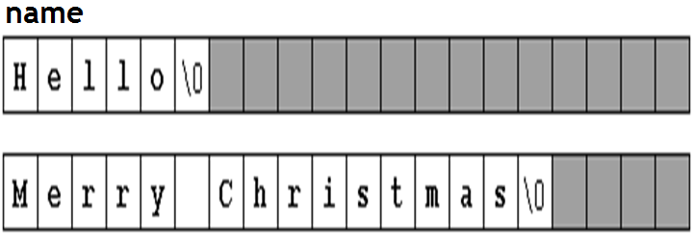
Strings
The character sequences "Hello" and "Merry Christmas" represented in an array name as follows :

Slide 57
String initialization
1. strings are ordinary arrays that follow the same rules of arrays.
For example:
a) char name[20] = “Manipal”;
b) char name[ ] = { 'H', 'e', 'l', 'l', 'o', '\0' };
c) char name[ ] = “How Are You?”;
2. Double quoted (") strings are called literal constants.
3. string literals enclosed between double quotes always have a null character ('\0') automatically appended at the end.
Notes:
Because a character is initialized by including it in single-quotes, when creating an array of characters, to initialize it, you must also include each letter accordingly. A name such as James can be initialized as follows:
char Name[6] = { 'J', 'a', 'm', 'e', 's' };

Slide 58
Example
#include <iostream.h>
#include<string.h>
void main ()
{
char question[] = "Please, enter your first name: ";
char greeting[] = "Hello, ";
char yourname [80];
cout << question;
cin >> yourname;
cout << greeting << yourname << "!";
getch();
}
Notes:
cin
gets()
It can be used to take input of a value of any data type.
It can be used to take input of a string.
It takes the white space i.e. a blank, a tab, or a new line character as a string terminator.
It does not take the white space i.e. a blank, a tab, or a new line character, as a string terminator.
It requires header file iostream.h
It requires the header file stdio.h
Example: char S[80]; cout<<"Enter a string:”; cin>>S;
Example: char S[80]; cout<<"Enter a string:"; gets(S);

Slide 59
Reading Embedded Blanks
To read text containing blanks we use function,
cin.get(array_name, size) ;
The first argument to cin.get() is the array name where
the string being input will be placed.
The second argument specifies the maximum size of the
array, thus automatically avoiding buffer overrun.
Also we use function gets() to read everything (including space). that we enter from the key board until the ENTER key is pressed (including space).
gets(array_name);
Ex. gets(string) ;
we can also use function puts() to display a string.
puts(array_name);
puts(string) ;
Notes:
Reading strings with/without embedded blanks
To read a string without blanks cin can be used cin>>str; To read a string with blanks cin.getline() or gets() can be used. cin.getline(str,80); -Or- gets(str);

Slide 60
Programs on Strings
Count the number of characters in a string
Count the number of words in a sentence
Change all lower case letters into uppercase in a sentence
Check whether a string is Palindrome or not
To convert a given string representing a number to an integer
Finding Substring in Main String
To count the number of vowels and consonants in a given string.
To Accept a String and display no of each Vowel
To Accept a String and display in Reverse
To Accept a String and display its alternate characters
To Accept a String and display Alternate characters in reverse case
To Accept a String and display its substring(Accept parameters from user) ex. substr(str,start_pos,no_of_chars)
Program to Accept 2 strings and display combination of two strings
Notes:
Reading strings with/without embedded blanks
To read a string without blanks cin can be used cin>>str; To read a string with blanks cin.getline() or gets() can be used. cin.getline(str,80); -Or- gets(str);

Slide 61
Library functions: String Handling functions (built-in)
Used to manipulate a given string.
These functions are part of string.h header file.
strlen ()
gives the length of the string. E.g. strlen(string)
strcpy ()
copies one string to other. E.g. strcpy(Dstr1,Sstr2)
strcmp ()
compares the two strings. E.g. strcmp(str1,str2)
strcat ()
Concatinate the two strings. E.g. strcat(str1,str2)

Slide 62
strlen()
String length can be obtained by using the following function
n=strlen(string);
This function counts and returns the number of characters in a string, where ‘n’ is an integer variable which receives the value of the length of the string.
The argument may be a character array OR a string constant.
Eg. 1) cout<<strlen(“Manipal”); prints out 7
Eg. 2) char name[10]= “Hello”;
cout <<strlen(name); prints out 5

Slide 63
Copying a string using a for loop
void main()
{
char str1[ ] = “Hello World”;
char str2[50]; //empty string
for(int i=0 ; i<strlen(str1); i++) //copy strlen characters
str2[i] = str1[i]; // from str1 to str2
str2[i] = ‘\0’; //insert NULL at end
cout << str2 << endl; //display str2
}
Notes:
Copying a String the Hard Way
It is not possible to copy one string to another, by assigning first string to second. For example is s1 and s2 are the 2 strings then: s2=s1; is an invalid statement. The best way to understand the true nature of strings is to deal with them character by character. The following program copies one string to another character by character.
The copying is done one character at a time, in the Statement str2[j] = str1[j];
The copied version of the string must be terminated with a null. However, the string length returned by strlen() does not include the null. We could copy one additional character, but it’s safer to insert the null explicitly. We do this with the line str2[j] = ‘\0’;
If you don’t insert this character, you’ll find that the string printed by the program includes all sorts of weird characters following the string you want. The << just keeps on printing characters, whatever they are, until by chance it encounters a ‘\0’.

Slide 64
strcpy()
strcpy(destination, source) ;
The strcpy() function assigns the contents of source to destination.
destination may be a character array or a string constant.
e.g., strcpy(city,”DELHI”);
will assign the string “DELHI” to the string variable city.
Similarly, the statement strcpy(city1,city2);
will assign the contents of the character array city2 to the character array city1.
The size of the array city1 should be large enough to receive the contents of city2.

Slide 65
strcpy(): Example
#include<string.h>
void main()
{
char str1[ ] = “Hello World”;
char str2[50]; //empty string
strcpy(str2, str1); //copy str1 to str2
cout << str2 << endl; //display str2
}

Slide 66
strcmp()
The strcmp() function compares two strings identified by the arguments and returns the following values:
A value 0 if they are equal.
The numeric difference between the first non matching characters in the strings if they are not equal.
strcmp(string1,string2);
string1 and string2 may be character array or string constants.
E.g., strcmp(“their” , ”there”); will return a value of –9 which is the numeric difference between ASCII “i” and ASCII “r”. That is, “i” minus “r” w:r:to ASCII code is –9.

Slide 67
strcat()
The strcat() function joins two strings together.
It takes the following form:
strcat(string1,string2);
where string1 and string2 are character arrays.
When the function strcat() is executed, string2 is appended to a string1.
It does so by removing the null character at the end of string1 and placing string2 from there.
The string at string2 remains unchanged.
The final concatenated string is placed in string1.

Slide 68
Concatenation of 2 strings
#include<iostream.h>
#include<conio.h>
#include<string.h>
#include<stdio.h>
void main()
{
char s1[40], s2[50];
cout<<"\nEnter the first string";
gets(s1);
cout<<"\nEnter the second string“;
gets(s2);
strcat(s1,s2);
cout<<"\nConcatenated string is“<<s1;
}

Slide 69
Reversing a string
void main()
{
char str[70];
char temp;
int i, n=0;
cout<<"\nEnter the string:";
gets(str);
//finding length
for(i=0;str[i]!='\0';i++)
n++;
//Reversing
for(i=0;i<n/2;i++)
{
temp=str[i];
str[i]=str[n-i-1];
str[n-i-1]=temp;
}
cout<<"\nReversed string is:";
puts(str);
}

Slide 70
Two Dimensional Character Array
It is an array of character arrays.
2-D character array consists of strings as its individual elements.
Declaration :-
char country[20][20];
Initialization:-
char country[3][20]={
“aaa”,
“bbb”,
“ccc”
};
→ ‘country’ is a 2D character array having:
1) 3 rows which indicate the 3 country names
2) Each row having maximum 20 characters in the country name.

Slide 71
Arrays of Strings
Example: Names of days stored in an array
void main()
{
char days[7][10] = { “Sunday”, “Monday”, “Tuesday”, “Wednesday”,
“Thursday”, “Friday”, “Saturday” };
//display every string
for(int i=0; i<7; i++)
cout << days[i] << endl;
}

Slide 72
Syntax
Declaration and initialization
char string_name[size];
char myword[ ] = { 'H', 'e', 'l', 'l', 'o', '\0' };
char result[14] =“the result is”;
char greeting[]=“hello world”;
Reading Strings
cin >> myword;
gets(string);
cin.get(array_name, size, stop_char) ;
String Functions (in-built)
n=strlen(string);
strcpy(destination, source);
strcmp(string1,string2);
strcat(string1,string2);
Arrays of Strings
char array_name[no_of-strings][no_of_chars];

Slide 73
Syntax
Declaration and initialization
char string_name[size];
char myword[ ] = { 'H', 'e', 'l', 'l', 'o', '\0' };
char result[14] =“the result is”;
Reading Strings
cin >> myword;
gets(string);
cin.get(array_name, size, stop_char) ;
string Functions (in-built)
n=strlen(string);
strcpy(destination, source);
strcmp(string1,string2);
strcat(string1,string2);
Arrays of Strings
char array_of_strings[no_of-strings][no_of_chars];
..
cin>>array_of_strings[i];

